Slide 1
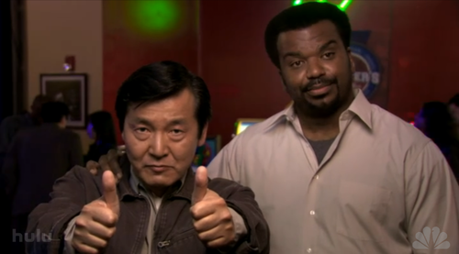
TEST DRIVEN DEVELOPMENT
At 10,000 feet
Let’s begin →
Notes:
Image source: http://25.media.tumblr.com/tumblr_l2690pvsbD1qa4lf5o1_r1_500.png

Slide 2
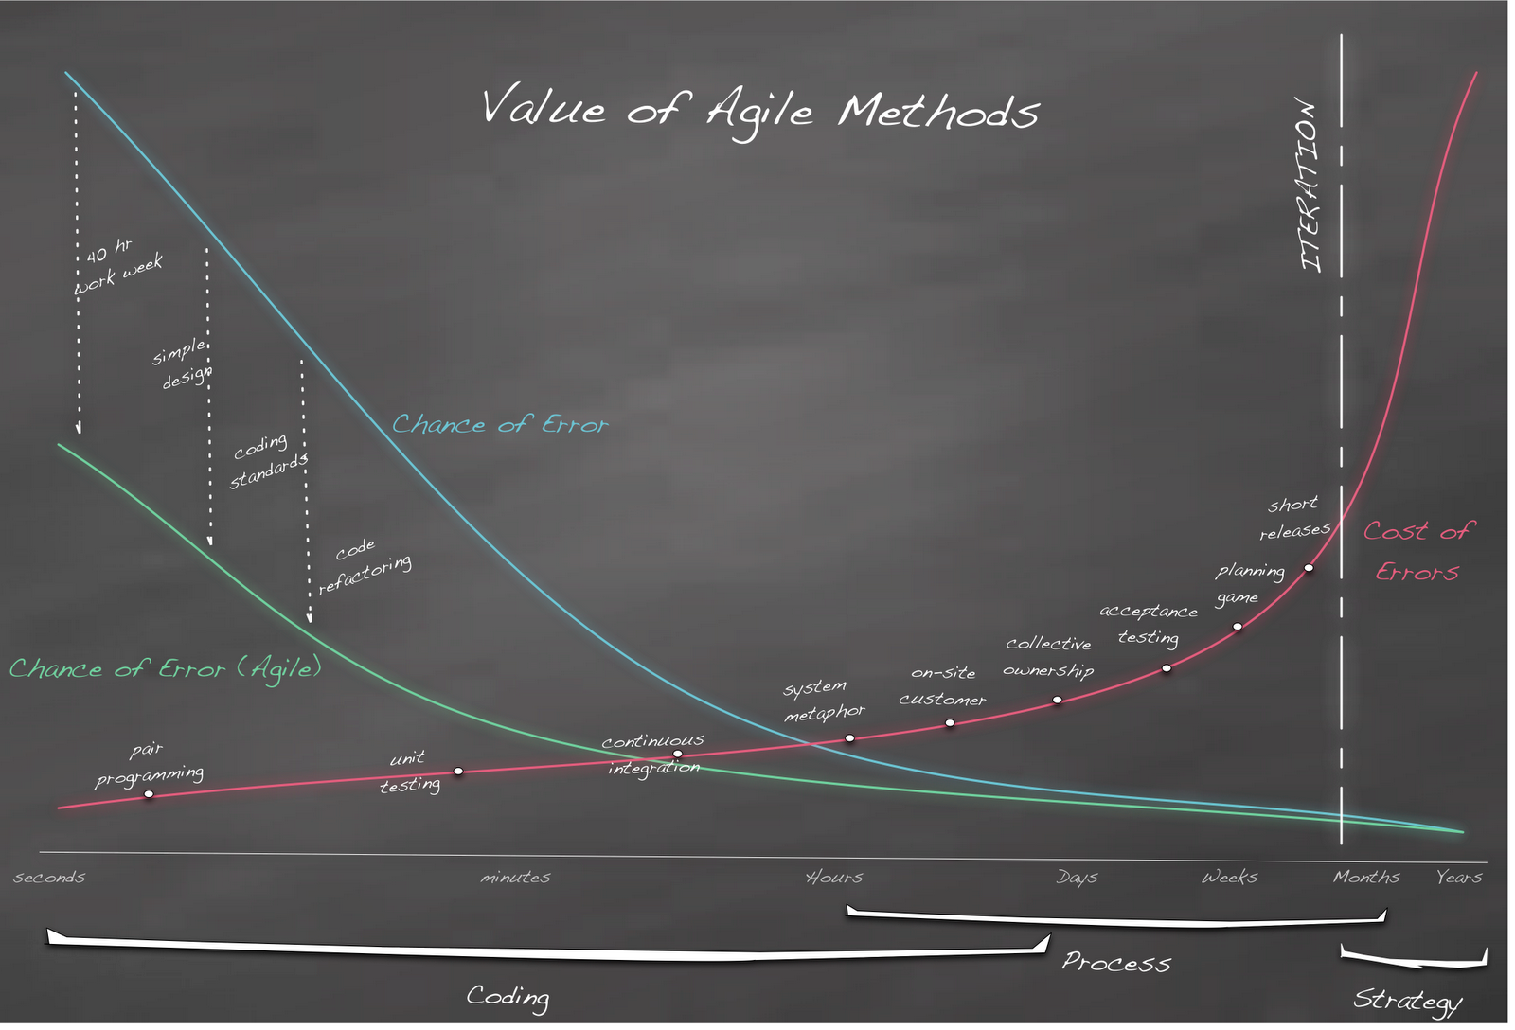
WHY TDD?
We need a way to find defects earlier on in the development cycle..
Notes:
Image Source: http://iformattable.blogspot.com/2010/09/real-software-engineering-agile-value.html

Slide 3
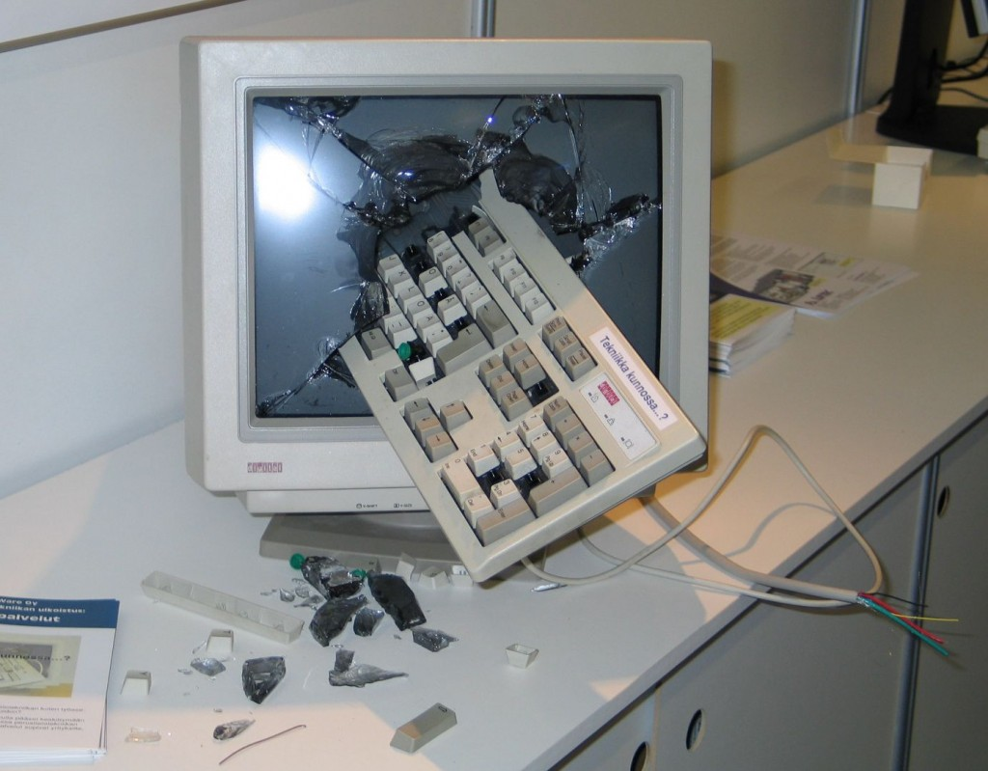
TDD REDUCES DEBUG TIME
Notes:
With TDD, at any point in time, everything a programmer was working on within a few minutes executed and passed all of its tests.
What would your life be like if everything always worked a minute or so ago? How much debugging would you need to do?
With such little time invested in creating the defect, removing the defect will not be difficult.
Image source: http://cdn.techi.com/wp-content/uploads/2010/06/smashedComputer-1024x799.jpg

Slide 4
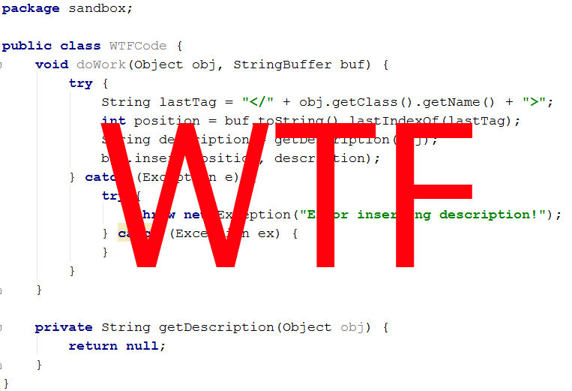
TESTS = CODE EXAMPLES
Notes:
As programmers, we are always looking to code examples to teach us how to use an API.
What better example of how to use the system is there than the unit test suite?

Slide 5
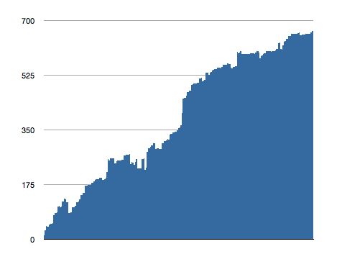
NO TDD = NO VELOCITY
The more complex our code becomes, the longer it takes to make changes or add new features.
Hard to change
Complexity
Time →
Easy to change
Notes:
Image source: http://michaelfeathers.typepad.com/michael_feathers_blog/2011/03/data-rich-development.html

Slide 6
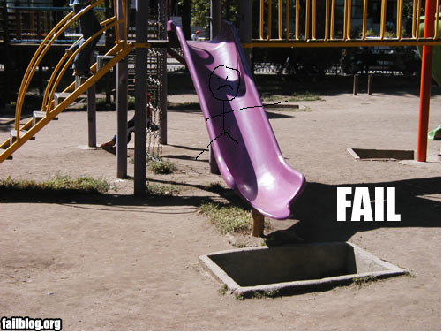
TDD PROTECTS US FROM OURSELVES
Automated tests remind us when we inadvertently screw up part of the code. No matter how significant.

Slide 7

TDD EMPOWERS YOU
Notes:
TDD gives you as a developer the courage to clean up code by telling you if you screwed something up right away.
If you see something wrong, FIX IT!

Slide 8
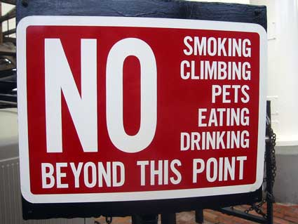
THE THREE RULES OF TDD
Notes:
Content Source: http://butunclebob.com/ArticleS.UncleBob.TheThreeRulesOfTdd
Image source: http://homepage.mac.com/jfstrain/blogpics/apr04/rules.jpg

Slide 9

RULE # 1
You are not allowed to write any production code unless it is to make failing unit tests pass.
Notes:
Image source: http://www.morningstarcomm.com/wp-content/uploads/2011/08/apple-number-one-in-phone-sales2.jpg

Slide 10
RULE #2
You are not allowed to write any more of a unit test than is sufficient to fail; and compilation failures are failures.

Slide 11
RULE #3
You are not allowed to write any more production code than is sufficient to pass the one failing test.

Slide 12
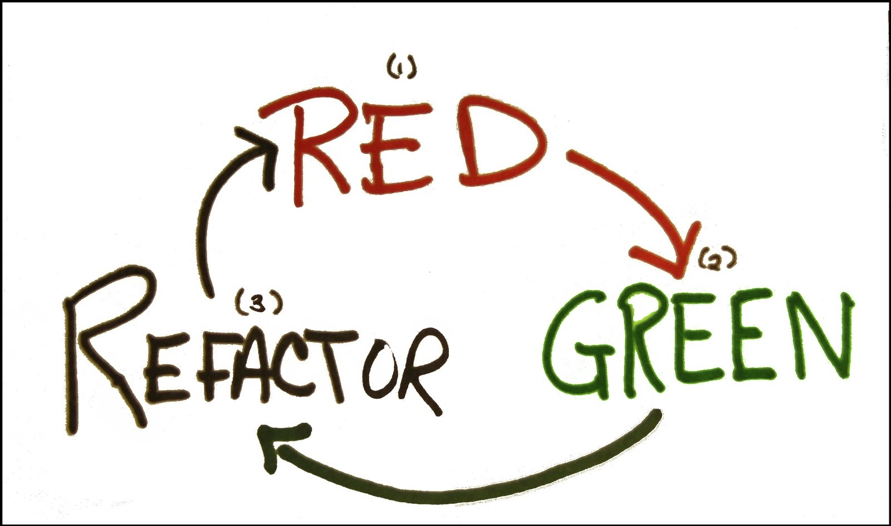
TDD IN PRACTICE
Notes:
Image Source: http://agileinaflash.blogspot.com/2009/02/red-green-refactor.html

Slide 13
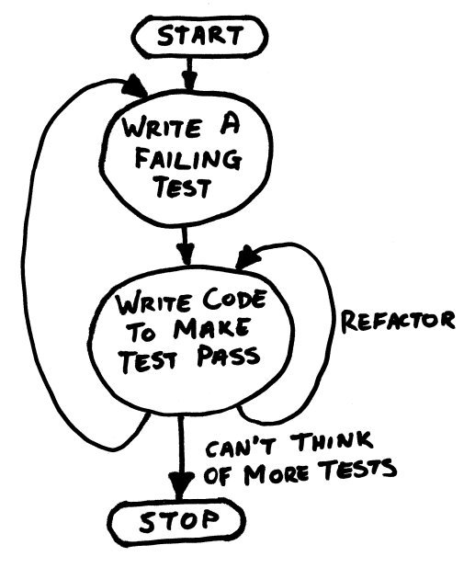
SAY WHAT?
Notes:
Image source: http://wellington.pm.org/archive/200606/tdd/images/tdd_cycle.jpg

Slide 14
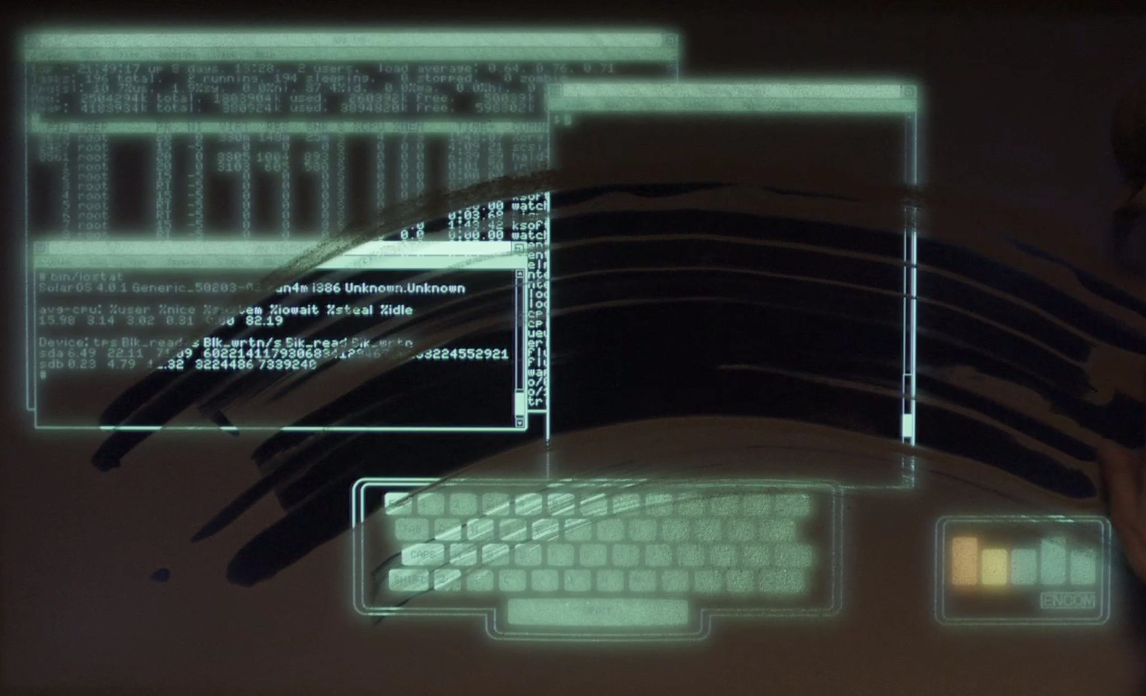
Let’s see some code
Notes:
Code example.

Slide 15
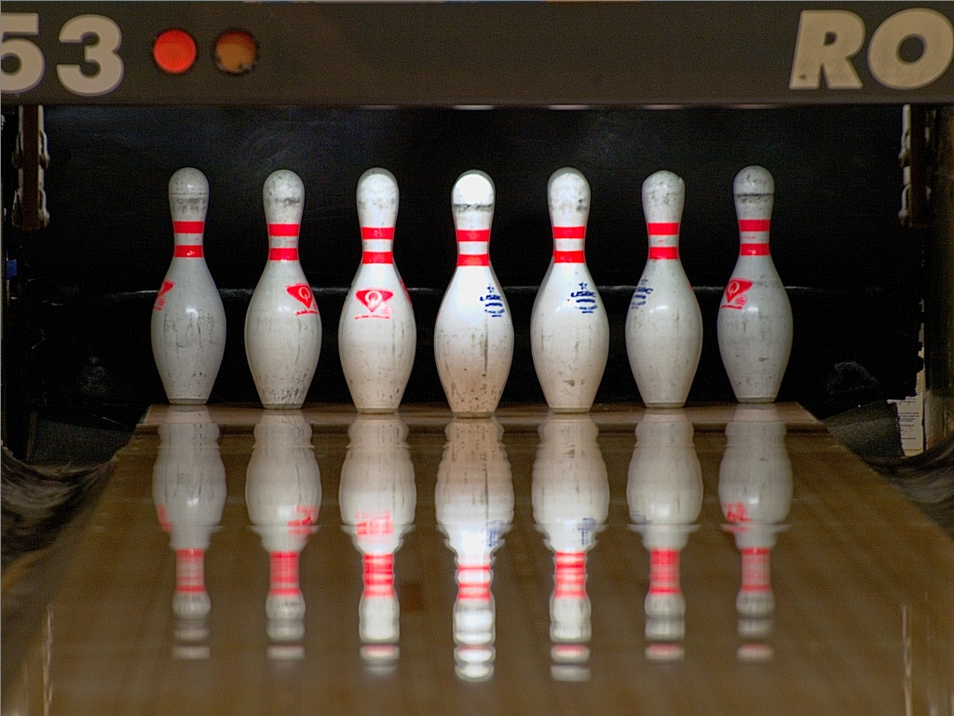
The Bowling Game
Notes:
Image source: http://blumonkey.org/weblog/pictures/large_PA191996-1.jpg
Content Source: http://butunclebob.com/ArticleS.UncleBob.TheBowlingGameKata

Slide 16

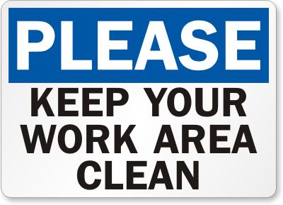
Test code is just as important as production code and should be shown the same level of respect and professionalism.
Notes:
http://agileinaflash.blogspot.com/2009/02/first.html

Slide 17
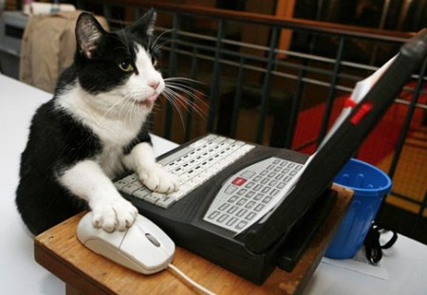
THANK YOU!
Any Questions?

